Slide 1
ARCHITECTURE EVALUATION TECHNIQUES
Group Members:
M Muaz Shahzad 02-131202-081
Usama Riaz 02-131202-082
Atif 02-131202-083

Slide 2
Content
Introduction
Why evaluate an architecture?
Techniques for evaluating an architecture
Benefits and Costs of Performing an Architecture Evaluation?

Slide 3
Introduction
Architecture evaluation is the activity of evaluating the architectural design decisions of an (envisioned) system to build confidence that the system can fulfill the stakeholder concerns.

Slide 4
Why Evaluate An Architecture ?
The earlier you find a problem in a SW project, the better off you are (the cost to fix an error in early design phase is much smaller than the cost to fix the same error in implementation/testing)
Architecture determines the structure of the project: schedules and budgets, performance goals, team structure, documentation organization, testing and maintenance activities.
Architecture is the earliest point in the project where trade-offs are visible
Risk management

Slide 5
Who Is Involved?
Evaluation Team: Who will conduct the evaluation and perform the analysis.
Stakeholders: Stakeholders are people who have a vested interest in the architecture and the system

Slide 6
Techniques For Evaluating An Architecture
A suit of three methods, all developed at the Software Engineering Institute (SEI).
ATAM: Architecture Trade-off Analysis Method
SAAM: Software Architecture Analysis Method
ARID: Active Reviews for Intermediate Designs

Slide 7
Architecture Tradeoff Analysis Method (ATAM)
This Method is used to evaluate the quality attributes(such as performance, availability, and security) of software architectures. It is used to mitigate risks in software architectures in the early stages of the Software Development Life Cycle (SDLC).

Slide 8
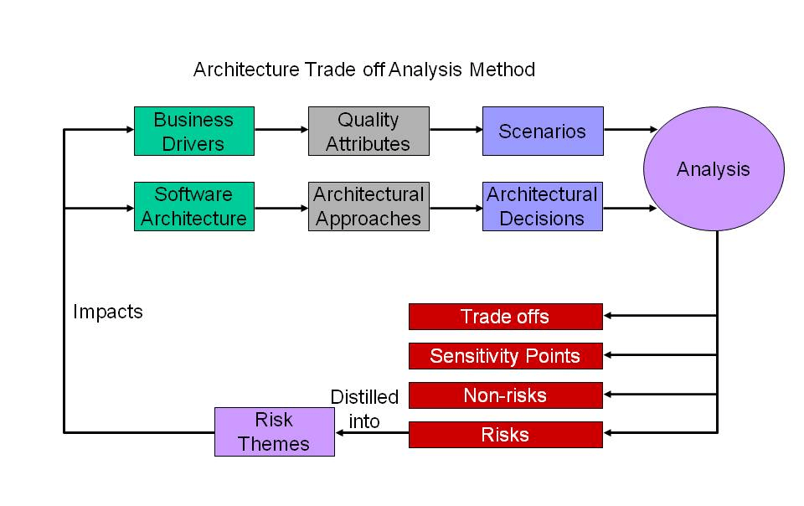
Architecture Tradeoff Analysis Method (ATAM)

Slide 9
Software Architecture Analysis Method (SAAM)
Based on scenarios
A scenario represents a description of a stakeholder's interaction with the system.
Scenarios are created depending on the point of view of each stakeholder:
Developer - interested in reusability, implementation, maintenance
Project Manager - interested in time, cost, quality, extensibility
Tester - interested in usability, mapping to requirements

Slide 10
Software Architecture Analysis Method (SAAM)
There are two classes of scenarios.
Direct scenarios: A scenario that describes behavior currently supported by the system. Direct scenarios are those that can be executed by the system without modification.
Indirect scenarios: A scenario that describes behavior that is not currently supported by the system. Indirect scenarios are those that require modifications to the system.

Slide 11
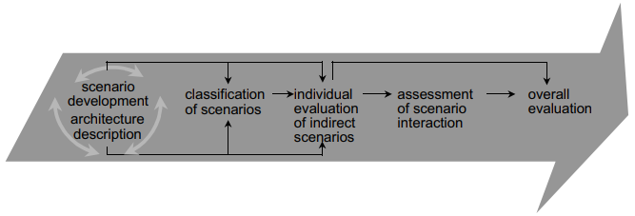
Interaction Of SAAM Steps

Slide 12
Software Architecture Analysis Method (SAAM)
Application Modifiability: This quality attribute refers to how easy it changing the system in the future will be.
Application Extensibility: This quality attribute refers to the ease of adding new features to the existing application without impacting existing functionality.
Application Robustness: This quality attribute refers to how an application can handles the unexpected.
Application Portability: This quality attribute refers to the ease of porting an application to run in a new operating system or device.

Slide 13
Active Reviews for Intermediate Designs (ARID)
Method for reviewing preliminary software designs (such as for a component or a subsystem) for suitability in its intended usage context and environment.
Result in a high-fidelity design review coupled with high-quality familiarization with the design.

Slide 14
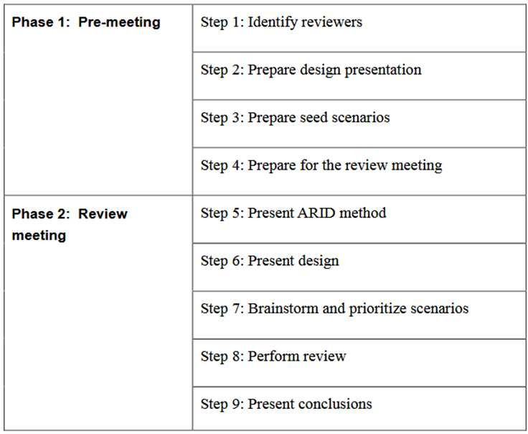
Active Reviews for Intermediate Designs (ARID)

Slide 15
What Are the Benefits & Costs
Forces an Articulation of Specific Quality Goals.
Results in the Prioritization of Conflicting Goals.
Puts Stakeholders in the Same Room.
Improves the Quality of Architectural Documentation.
Uncovers Opportunities for Cross-Project Reuse.

Slide 16
Conclusion
The average architecture evaluation adds no more than a few days to the project schedule.
Architecture created in haste will precipitate disaster: performance goals not met, Security goals falling, customer dissatisfaction, system that is too hard to change, and schedules and budgets through the roof.

Slide 17


Slide 18


